Slide 1
SI 608 Midpoint Report
Jainabou Barry Danfa
November 2019

Slide 2

Research Question and Motivation
Recommending products based on previous order history
Helps customers find products they may be interested in
Helps companies increase revenue through targeted recommendations
Analyze Amazon co-purchasing data and create a model to predict the other products co-purchased with a product

Slide 3
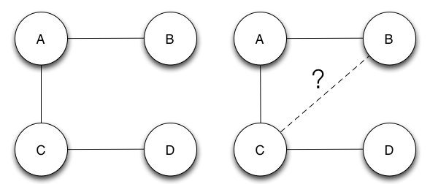
Related Works [Link Prediction]
Uses a network structure to predict the most likely links to form in the network
Different similarity measures and link prediction functions that can be used to predict links in a network
Previous works saw prediction improvement when node neighborhood data was combined with node attributes in social networks
Image from: https://www.researchgate.net/figure/Link-Prediction-an-example_fig7_281319964, https://indatalabs.com/blog/big-data-behind-recommender-systems

Slide 4
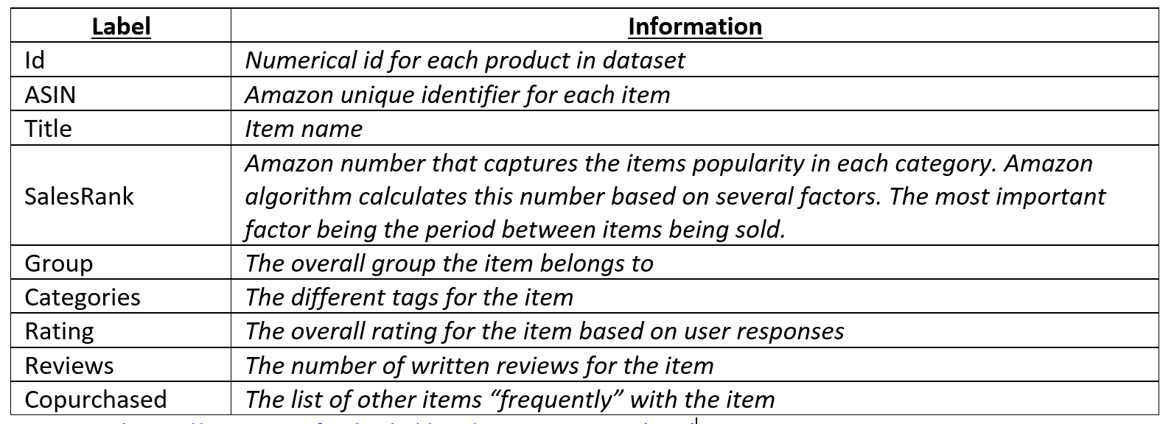
Datasets and Data Collection [Amazon Product Meta-Data]
Stanford SNAP database
Product metadata for Books, Music, CDs, DVDs and VHS Tapes and other categories.
548,552 products represented in the file
Text file containing information from summer 2006

Slide 5
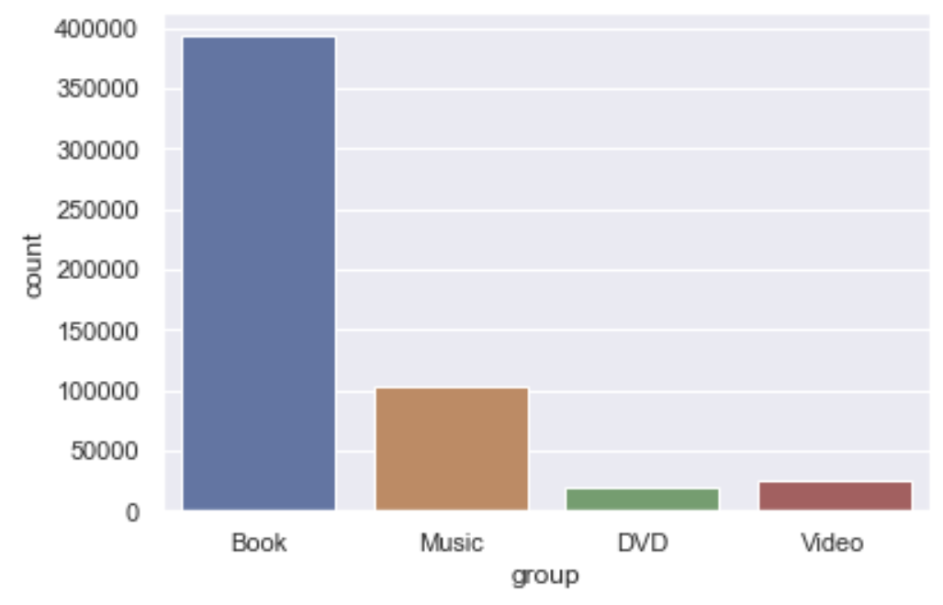
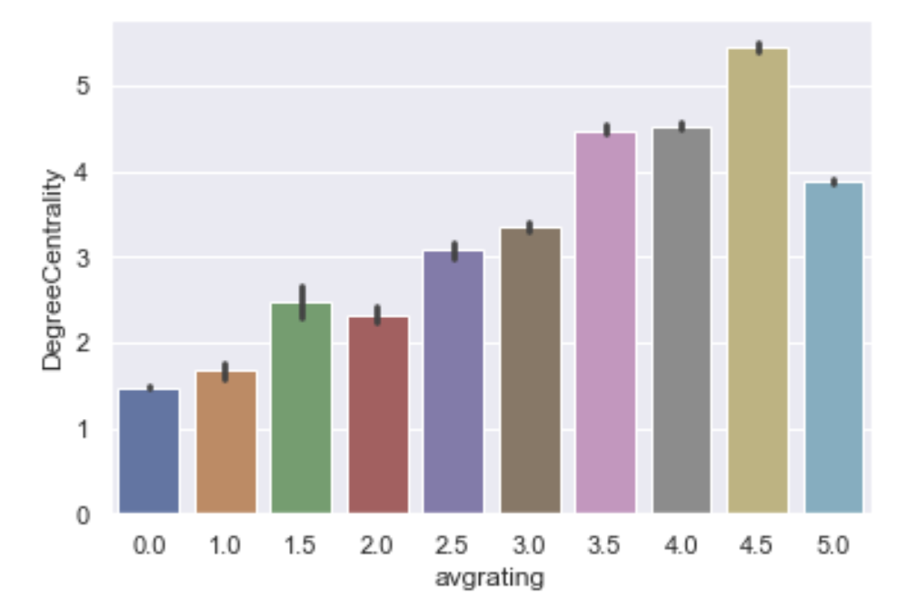
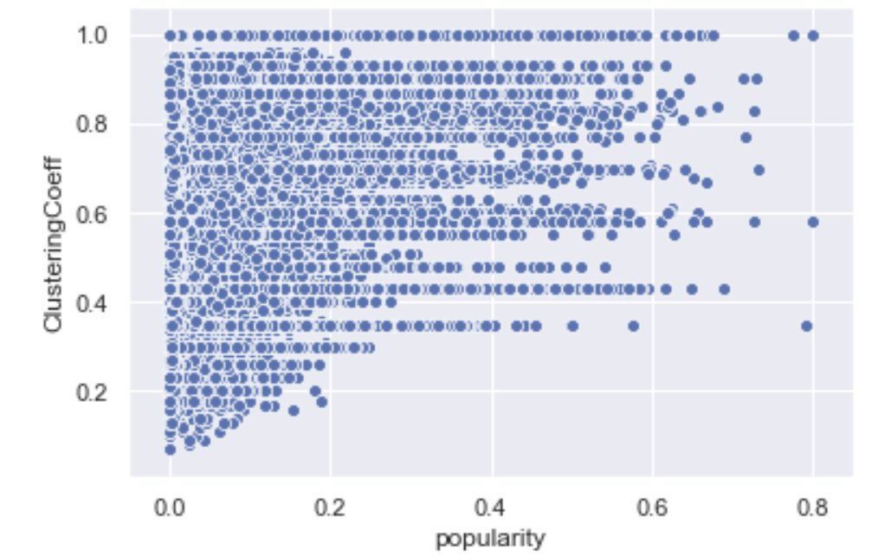
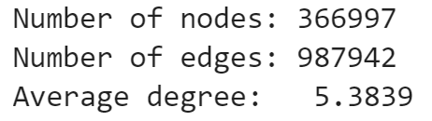
Data Analysis [Co-purchasing Network]
Relationship between item degree and average rating
Relationship between clustering coefficient and item popularity
Undirected Graph
Density: 0.0000146

Slide 6
Model Development [Network Measures]
Measure | Description
Category Similarity | based on the number of words that intersect between the two category descriptions over the union of all words in the category descriptions.
SalesRank | It is an indicator of the popularity of the item in the amazon purchasing network
Jaccard Coefficient | measure of the neighborhood similarity of two nodes. It is an indicator of the relationships that may exist because they share the same neighborhoods
Resource Allocation Index | measure of common neighbors the two nodes have and the fraction of co-purchases that can occur using the common neighbors. This metric was calculated for the co-purchasing pairs and assumed zero for non-co-purchased pairs
Preferential Attachment | measure of the degree correlation of the two nodes. It assumes that the a connection will be more likely given both nodes have higher degrees.

Slide 7
Model Development [Machine Learning]
DataSet
1.4 mill pairs of items
987k co-purchased
500k non-co-purchased
Test-Train Split
80/20 stratified spilt
Models
Logistic Regression
Gradient Boosting Classifier
Random Forest Classifier
Testing
AUC ROC
Accuracy

Slide 8
Model Performance [Link Prediction]
AUC ROC Score
Accuracy Score
Baseline

Slide 9
Model Performance [Feature Importance]

Slide 10
Conclusions
We saw the predictive power that network attributes can add to a machine learning model.
The most important features in predicting a link in this network was the category similarity of the two products and the Resource Allocation Index highlighting that common neighbors and common categories are the most indicative features of two products being co-purchased together
Further analysis can add more attributes to improve accuracy score and use on different networks.

